Slide 1
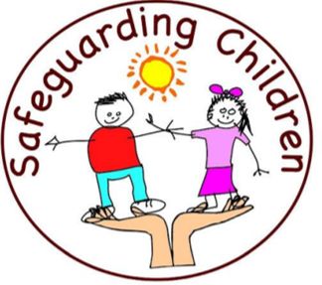
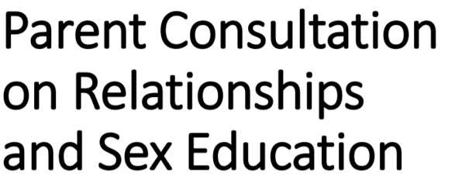

Slide 2
RSE stands for “relationships and sex education” and as part of Relationships and Health Education, is a new approach to teaching children about relationships and health.
The current curriculum has not been updated for 20 years. So much change has happened since then. Children need to learn what is relevant to them and the world they are growing up in.
The new Relationships and Health Education curriculum is designed to:
Help all children grow up healthy, happy and safe.
Give all children the knowledge to make informed decisions about their wellbeing, health and relationships.
Support all children to manage the challenges and opportunities of modern Britain.
Prepare all children for a successful adult lives.

Slide 3
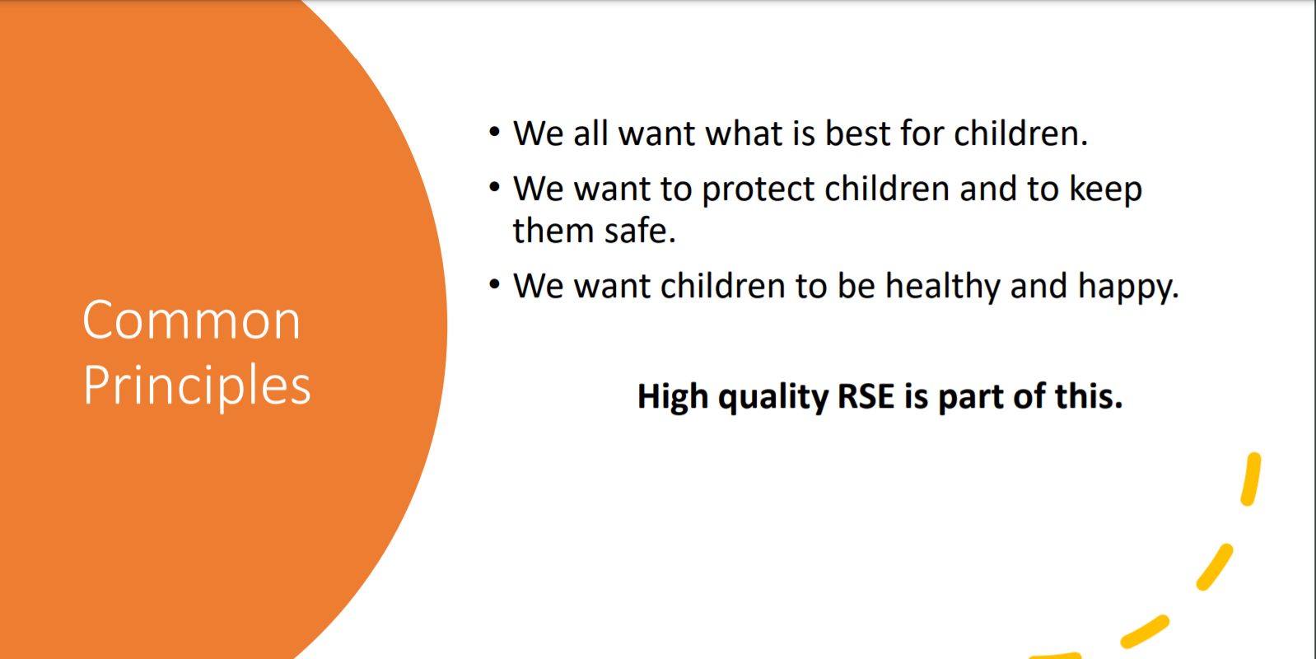

Slide 4
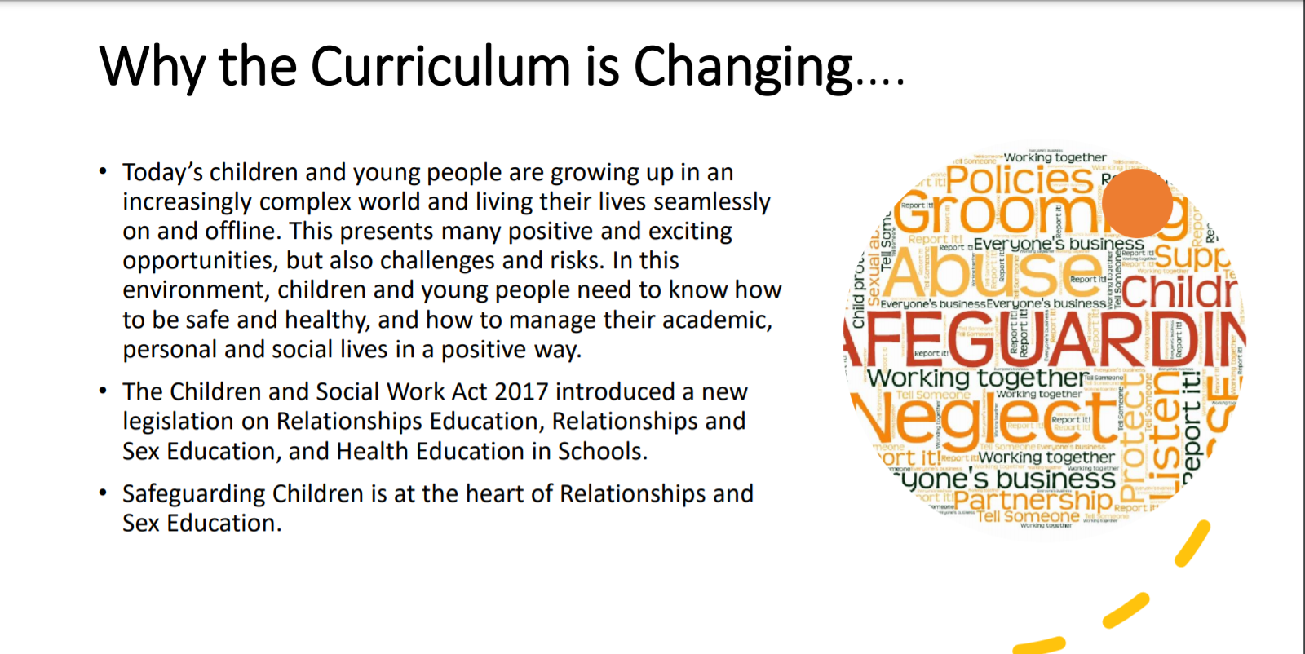

Slide 5
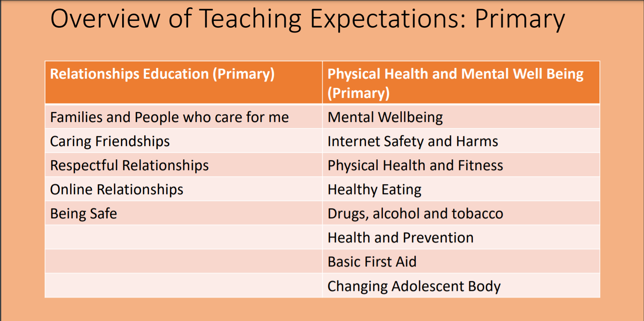

Slide 6
What are the benefits of teaching RSE?
RSE explains the positive qualities of relationships, such as trust, respect and commitment as well as recognising that there are different types of relationships and families.
It raises the importance of educating children about gender equality, consent, relationships and sex in an age-appropriate way.
RSE can provide young people with the knowledge required to resist peer, partner and media pressure and understand issues of consent as well as what is and is not appropriate behaviour.
There is evidence that good quality RSE teaching can help young people to:
Have consensual relationships
Delay the age of first sexual encounters
Prevent underage pregnancy
Know who to report abuse to
Have improved sexual health

Slide 7
Relationships
Education
What should children know about relationships and why?
What a positive, healthy, caring, safe relationship looks and feels like
How to speak up and get help when a relationship does NOT feel healthy/positive/safe
How to make and maintain positive relationships
(Online and offline relationships)

Slide 8
What does the government say is the aim of Relationships Education?
‘Today’s children and young people are growing up in an increasingly complex world and living their lives seamlessly on and offline….children and young people need to know how to be safe and healthy, and how to manage their academic, personal and social lives in a positive way’
DfE Guidance on Relationships Education, Sex Education and Health Education 2019
© Jigsaw PSHE

Slide 9
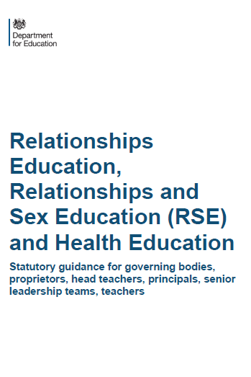
What have schools got to teach?
PRIMARY
RELATIONSHIPS EDUCATION IS COMPUSLORY
HEALTH EDUCATION IS COMPULSORY
But Sex Education is at school’s discretion
SECONDARY
RELATIONSHIPS EDUCATION IS COMPULSORY
SEX EDUCATION IS COMPULSORY
HEALTH EDUCATION IS COMPULSORY
Guidance does not apply to: Sixth Forms colleges, 16-19 academies or FE colleges

Slide 10
What are the expectations for Primary Health Education?
Mental wellbeing
Internet safety and harms
Physical health and fitness
Healthy eating
Drugs, alcohol and tobacco
Health and prevention
Changing adolescent body

Slide 11
What are the expectations for Primary Relationships Education?
Families and people who care for me
Caring friendships
Respectful relationships
Online relationships
Being safe
© Jigsaw PSHE

Slide 12
Science and Sex Ed at KS1
Science Key Stage 1
identify, name, draw and label the basic parts of the human body (using scientific terms) and say which part of the body is associated with each sense
notice that animals, including humans, have offspring which grow into adults
Non statutory note: Pupils should be introduced to …the processes of reproduction and growth in animals. The focus at this stage should be on questions that help pupils to recognise growth; they should not be expected to understand how reproduction occurs.
© Jigsaw PSHE

Slide 13
Science and Sex Ed at KS2
Science Key Stage 2
Non statutory note: Pupils should find out about different types of reproduction, including sexual and asexual reproduction in plants, and sexual reproduction in animals. Pupils should be introduced to …the processes of reproduction and growth in animals. The focus at this stage should be on questions that help pupils to recognise growth; they should not be expected to understand how reproduction occurs.
describe the differences in the life cycles of a mammal, an amphibian, an insect and a bird
describe the life process of reproduction in some plants and animals
describe the changes as humans develop to old age
learn about the changes experienced in puberty
© Jigsaw PSHE

Slide 14
Keeping children SAFE
Ignorance does not protect innocence…
but may make children vulnerable.
PSHE (Personal, Social, Health Education) including Relationships Education, Health Education and Sex Education aims to keep children safe.
We believe we need to teach Relationships and Sex Education alongside the Science curriculum. To ensure that we keep our children safe.
© Jigsaw PSHE

Slide 15

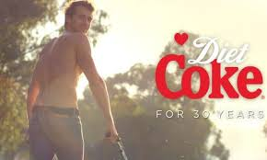
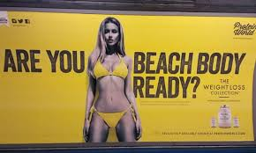

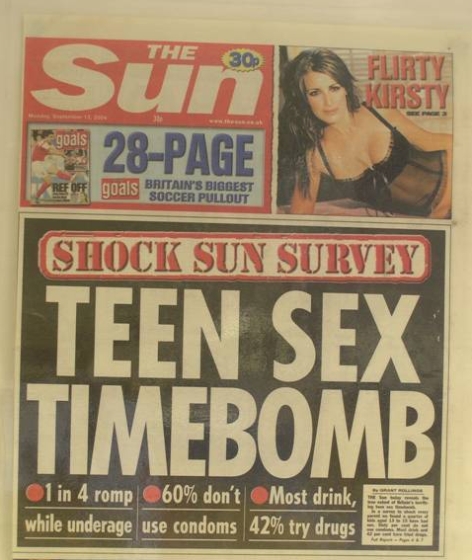


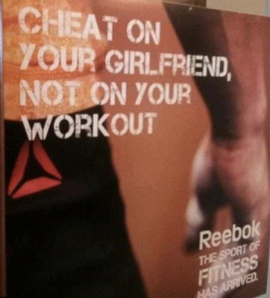

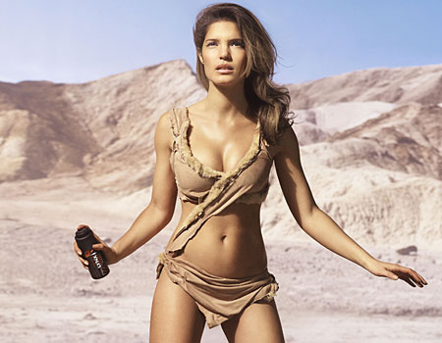

Today’s considerations
The internet
Television
Social media
Other media
Friends
Family
School
© Jigsaw PSHE

Slide 16
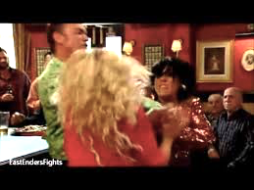
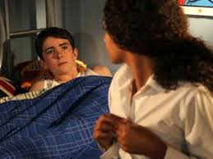
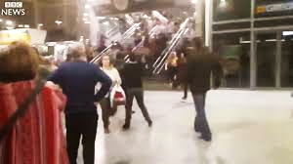
What ‘messages’ are in these TV scenes?
Eastenders ‘Kat vs Roxy’
Hollyoaks ‘Finn and Amber sleep together’
BBC News ‘ Manchester Arena Attack’
© Jigsaw PSHE

Slide 17
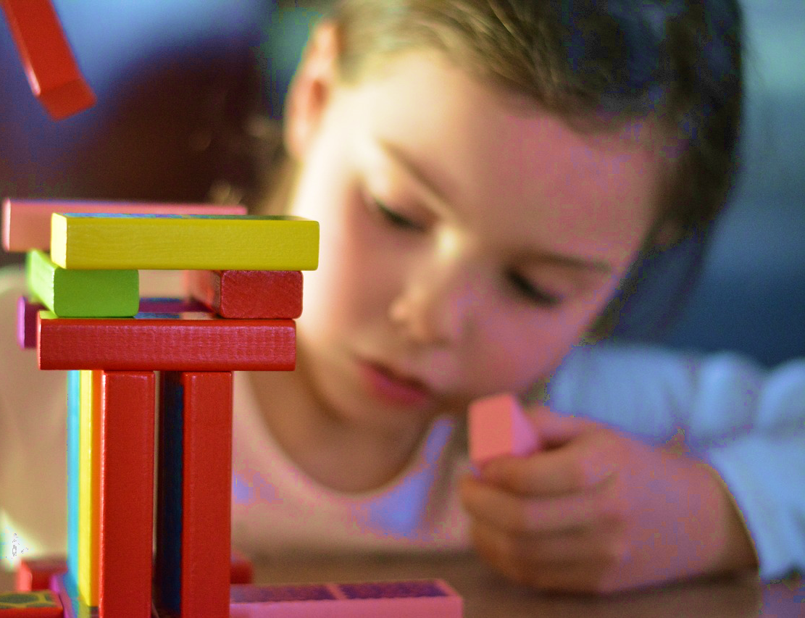
Don’t forget…
When it comes to sex, children’s heads are probably not empty – but they may be full of myths and half-truths
Our focus should be on building healthy attitudes and positive relationships, not just fighting off perceived threats

Slide 18

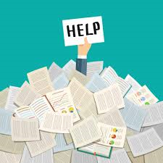
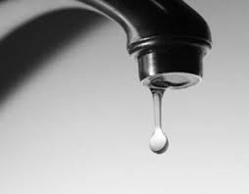
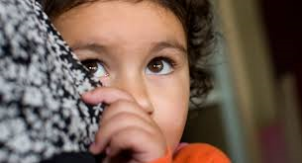
Which teaching approaches to RSE do these pictures represent?
If RSE is so important, which approaches are best?

Slide 19
Is there a better way?
Would accurate information at the right age and stage of development, coming from school AND home, be a better way?

Slide 20
Why are LBGT issues included?
There has been much mis-information in the media about how LGBT+ issues are to be taught within the Relationships, Health and Sex Education curriculum in primary schools. We believe that all pupils should be taught about the society in which they are growing up. Relationships Education is designed to foster respect for others and for difference and educate pupils about healthy relationships. We also believe that children should receive teaching on LGBT content during their school years. Teaching children about the society that we live in and the different types of loving, healthy relationships that exist is very important.
The DFE have stated:
“Pupils should be able to understand the world in which they are growing up, which means understanding that some people are LGBT, that this should be respected in British society, and that the law affords them and their relationships recognition and protections”
Sexual orientation is a protected characteristic, as defined by the Equality Act 2010, and therefore it is illegal to show prejudices against anyone for it.
Throughout our school we show respect for others and celebrated our differences.

Slide 21
Schools must comply with The Equality Act 2010
‘Schools must not unlawfully discriminate against pupils because of their age, sex, race, disability, religion or belief, gender reassignment…or sexual orientation (protected characteristics)
‘Schools should be alive to issues such as everyday sexism, misogyny, homophobia and gender stereotypes and take positive action to build a culture where these are not tolerated’
PSHE is a key part of this. All children are valued and included.

Slide 22
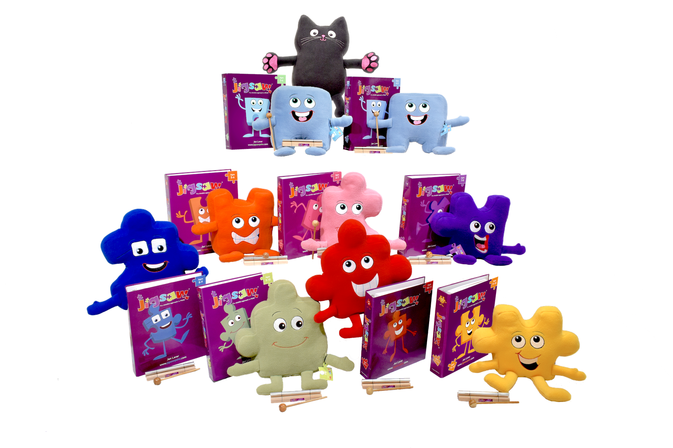
So, what, where, when and how do we do this?…

Slide 23
Whole-school approach from 3-16
Being Me in My World
Celebrating Difference
Dreams and Goals
Healthy Me
Relationships
Changing Me
Relationships
Values
Mental health
Self-esteem
Social skills
Safeguarding inc.
Internet safety

Slide 24
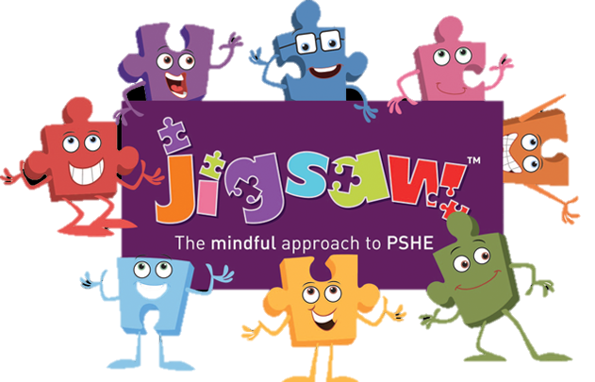
How will we be teaching RSE?
We have recently purchased ‘Jigsaw, the Mindful Approach To PSHE’. You may have heard your child talk about this at home.
The Jigsaw PSHE Programme includes lessons on ALL aspects of compulsory Relationships and Health Education, designed in a sensitive, spiral, age-appropriate curriculum. The Jigsaw teaching materials integrate Personal, Social, Health Education (PSHE), emotional literacy, social skills, mindfulness, and spiritual development in a whole-school approach.
The expectations of the DfE Relationships and Health Education guidance are woven throughout Jigsaw but specifically covered in the Relationships and Healthy Me Puzzles (units), with puberty and human reproduction being taught in the Changing Me Puzzle.

Slide 25
Jigsaw’s ‘Changing Me’ unit is taught over a period of 6 weeks, usually in the second half of the summer term. Each year group will be taught appropriate to their age and developmental stage, building on the previous years’ learning.
At no point will a child be taught something that is inappropriate; and if a question from a child arises and the teacher feels it would be inappropriate to answer, (for example, because of its mature or explicit nature), the child will be encouraged to ask his/her parents or carers at home.
The question will not be answered to the child or class if it is outside the remit of that year group’s programme
What is included in the ‘Changing Me’ unit?

Slide 26
The Changing Me Puzzle is all about coping positively with change and includes:
Reception - Growing up: how we have changed since we were babies.
Year 1 - Boys’ and girls’ bodies; correct names for body parts.
Year 2 - Boys’ and girls’ bodies; body parts and respecting privacy (which parts of the body are private and why this is).
Year 3 - How babies grow and how boys’ and girls’ bodies change as they grow older. Introduction to puberty and menstruation.
Year 4 - Internal and external reproductive body parts. Recap about puberty and menstruation. Conception explained in simple terms.
Year 5- Puberty for boys and girls in more detail including the social and emotional aspects of becoming an adolescent. Conception explained in simple biological terms.
Year 6 - Puberty for boys and girls revisited. Understanding conception to the birth of a baby. Becoming a teenager. All lessons are taught using correct terminology, child-friendly language and diagrams.

Slide 27
So, what next?
As a school we are consulting with you about our scheme and policy for RSE.
The policy, presentation and further information can be found on our school website under RSE. The government guidance about RSE can also be found on our website. We would encourage you to read the guidance as well as our policy.
We invite all parents and carers to submit comments and questions regarding our policy and proposed scheme. If you wish to make submit a comment or query, please contact us via ask@priestley.wilts.sch.uk before Monday 17th May 2021.

